Slide 1
CIS 18

Slide 2

What is the CIS 18?
What is it?
A list of critical controls that you can implement, as a roadmap to having a good security program.
History
Formerly known as the SANS Top 20
This project took on a life of its own and evolved into CIS Critical Security Controls.
CIS / the Center of Internet Security is the nonprofit organization that maintains and evolves the CIS 18.
Why are there 18 now?
CIS v8 reorganized them by the types of activities, as opposed to who does them.
This reorganization combined with a decreased emphasis/relative importance of physical controls, collapsed them down from 20 to 18 control categories.

Slide 3

How to use the CIS 18
Where it is useful:
It is a great high-level checklist, to understand the elements of an effective security program.
It includes some supporting detail and an assessment tool, but there are gaps IMHO, once you get down into the detail.
Limitations:
Frameworks like this evolve slowly and require lots of deliberation, so newer technologies may be pretty critical before they get rolled in.

Slide 4
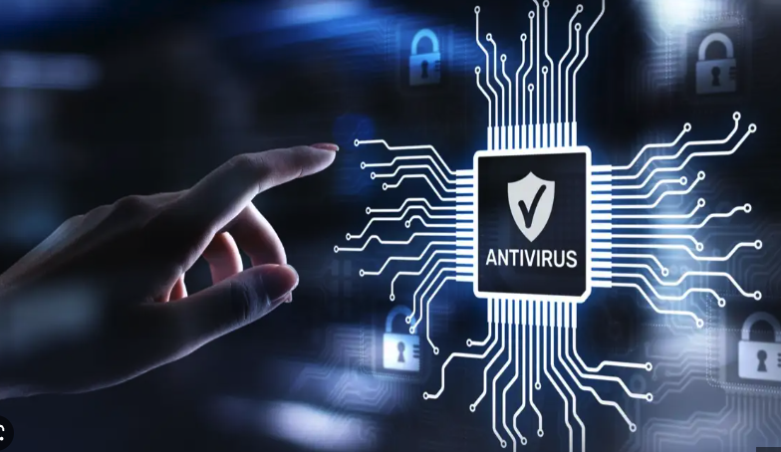

What are the 18 Controls (at a glance)?
CIS Control 1: Inventory and Control of Enterprise Assets
CIS Control 2: Inventory and Control of Software Assets
CIS Control 3: Data Protection
CIS Control 4: Secure Configuration of Enterprise Assets and Software
CIS Control 5: Account Management
CIS Control 6: Access Control Management
CIS Control 7: Continuous Vulnerability Management
CIS Control 8: Audit Log Management
CIS Control 9: Email and Web Browser Protections
CIS Control 10: Malware Defenses
CIS Control 11: Data Recovery
CIS Control 12: Network Infrastructure Management
CIS Control 13: Network Monitoring and Defense
CIS Control 14: Security Awareness and Skills Training
CIS Control 15: Service Provider Management
CIS Control 16: Application Software Security
CIS Control 17: Incident Response Management
CIS Control 18: Penetration Testing

Slide 5

Finding and Protecting Assets
CIS Control 1: Inventory and Control of Enterprise Assets
Tracking and managing your workstations, servers, mobile devices, and all other connected devices (can also include cloud, IOT, SCADA, etc.)
CIS Control 2: Inventory and Control of Software Assets
Finding and managing the lifecycle of software products.
These can range from desktop software running on user workstations to large enterprise solutions that are critical to service delivery.
Also very intertwined with Application Software Security (16).
CIS Control 4: Secure Configuration of Enterprise Assets and Software
Once you know where systems and enterprise software are all located, it is time to lock it down and protect it.
Very closely related Application Software Security (16) and Continuous Vulnerability Management (7).

Slide 6
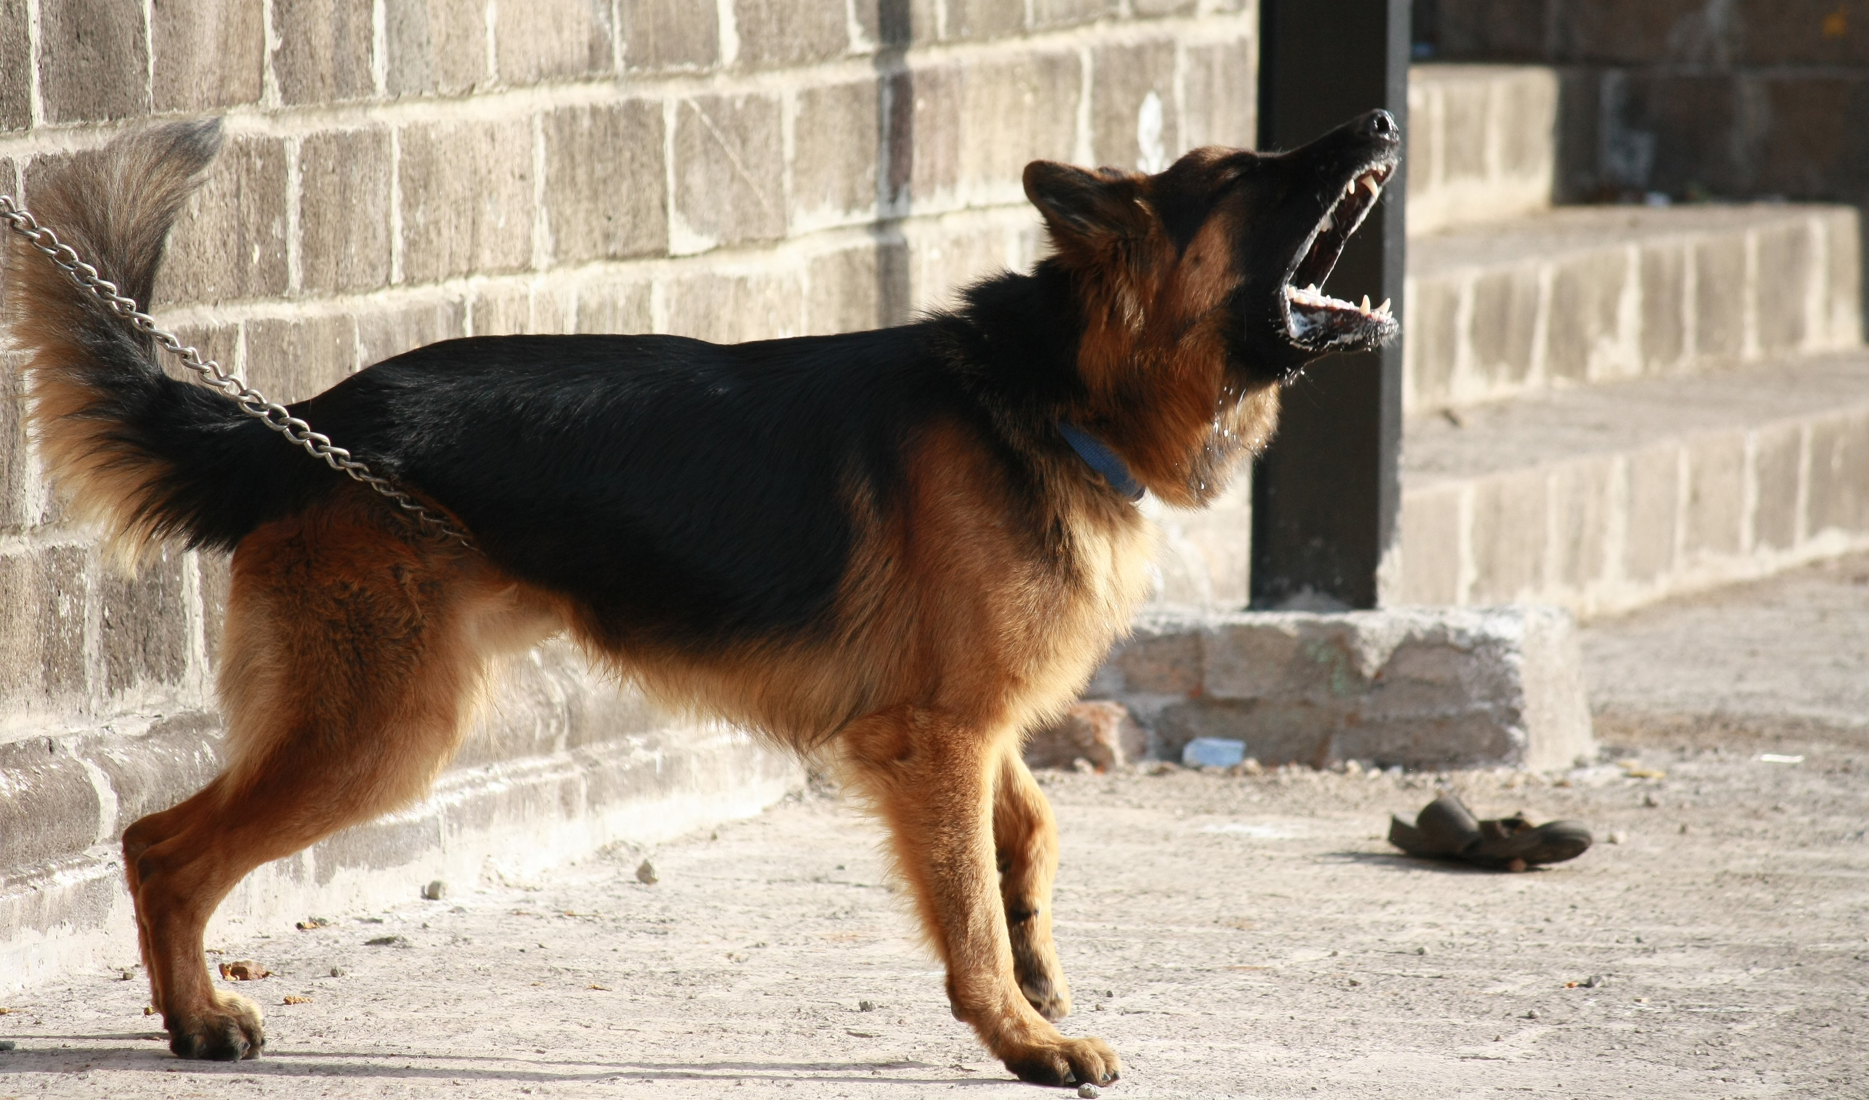
Protecting Data
CIS Control 3: Data Protection
Data discovery
DLP: Data Loss Prevention
UEBA: User Entity Behavior Analytics
Also closely connected with IAM aspects (especially UEBA).
CIS Control 11: Data Recovery
Backup and recovery strategies.
Immutable cloud storage, tape backup, and vaulting.

Slide 7

Identity and Access Management (IAM)
IAM Controls
CIS Control 5: Account Management
CIS Control 6: Access Control Management
Elements of IAM:
Provisioning of Accounts (and deprovisioning)
Authentication.
Authorization.
Involves Directory Services (AD/AAD), federation, MFA, etc.
Also, includes elements such as Conditional Access, Zero Trust, UEBA, PAM, etc.
This Photo by Unknown Author is licensed under CC BY-SA

Slide 8
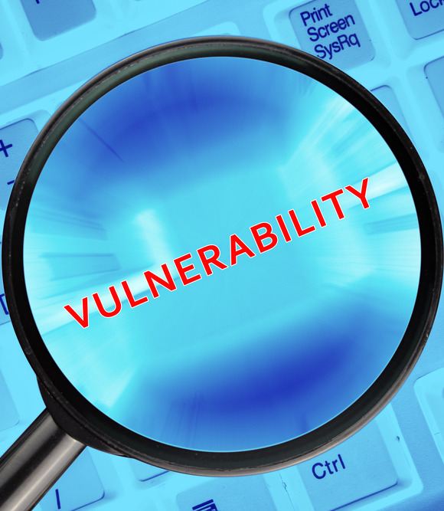
Vulnerability Management / GRC
CIS Control 7: Continuous Vulnerability Management
Network scans (detection of devices and vulnerabilities)
Agent-based scans
Detection on-the-wire (NDR or asset management feature overlap)
CIS Control 16: Application Software Security
CI/CD pipelines
Static code analysis
Web application scanning
CIS Control 18: Penetration Testing
Purple teaming, internal continuous assessment
Outside assessments
Validate malware defenses using realistic TTPs (tools, techniques, procedures)
CIS Control 15: Service Provider Management
Vendor risk assessment (OSINT, Questionnaires, Secure Integration, etc.)
This Photo by Unknown Author is licensed under CC BY-SA-NC

Slide 9

Email and Web Protections
CIS Control 9: Email and Web Browser Protections
Email gateway (reputation, link detonation, sandboxing, etc.)
Automation of response for known bad and ability for SOC to pull emails.
SPF/DKIM/DMARC
Browser Isolation
URL/DNS protection on host and/or network level
Abuse mailbox management
CIS Control 14: Security Awareness and Skills Training
Training courses (usually online, mandatory)
Awareness updates (email, intranet, etc.)
Contests and employee engagement
Phishing simulations and continuous testing

Slide 10

Network Defenses
CIS Control 12: Network Infrastructure Management
Edge firewalls
Networks segmentation and inspection
L7 vs L3 protections
SSL/TLS inspection
Micro-segmentation
CIS Control 13: Network Monitoring and Defense
NDR and IDS
Spanning/inspecting traffic intelligently
Closely related to Audit Log Management (8) for the purpose of Incident Response (17).
This Photo by Unknown Author is licensed under CC BY-NC

Slide 11
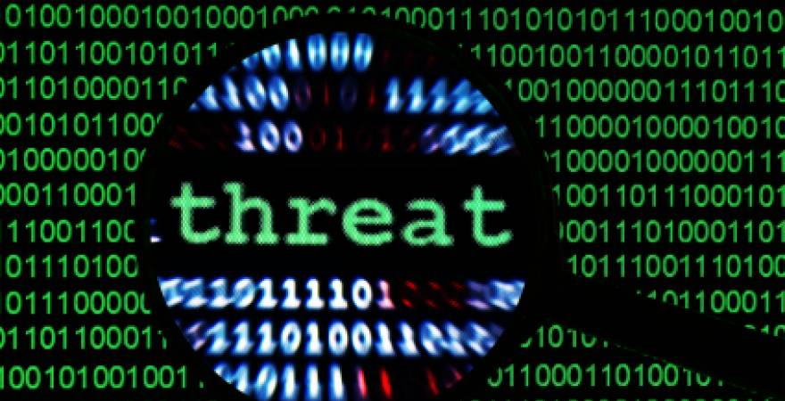
Responding to Threats
CIS Control 17: Incident Response Management
Processes:
CTI: Cyber Threat Intelligence
SOC: Security Operations Center (Triage)
Incident Response
Forensics
Tools and Technologies:
SIEM
SOAR
EDR
CIS Control 8: Audit Log Management
This is basically the data used, for the processes and tools mentioned above.
Log management, correlation and intelligence enrichment identify the work that flows into a SOC and IR process.
This Photo by Unknown Author is licensed under CC BY-SA-NC

Slide 12
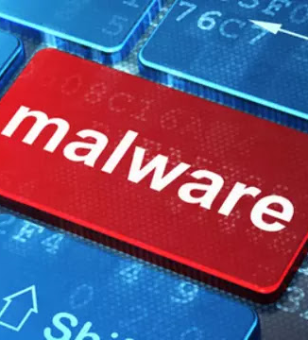
CIS Control 10: Malware Defenses
Um, what?
Wait, isn’t that all of these, really?
It is, although in this case, they mean endpoint products.
Like some other areas, what they recommend here is rather dated in some regards.
Specific Controls:
NGAV
EDR
Application Control and Script Control
Host Firewall
Host URLF
This Photo by Unknown Author is licensed under CC BY-NC

